Slide 1
Customer Service Message Tone Classification
ARI 410/510 | Project Phase 1: Task and Annotation Setup
Venkat | Vishnu | Roshkrishna
Notes:
Introduce the team and the task: classifying the tone of customer messages in support conversations.

Slide 2





Why It Matters
Spot customers who need attention
Help write better replies
Frustrated or escalating customers can be flagged, so a person looks at them sooner.
Knowing a customer is upset helps an agent or a bot reply the right way, or hand over to a human.
Find repeated problems
New labels for a hard problem
Many upset customers about the same issue, like late deliveries or refunds, point to something worth fixing.
2.8M support tweets, zero tone labels. “Thanks a lot” can be praise or sarcasm, so you need the whole conversation.
Notes:
Companies get thousands of support messages a day. Tone tells us how the customer is reacting to the help they get.
Spot customers who need attention: frustrated or escalating customers can be flagged so a person looks at them sooner. Tone is one signal, next to what the customer actually needs.
Help write better replies: an upset customer should not get a cheerful script. Tone helps pick the right words, or decide to bring in a human.
Find repeated problems: if many people are upset about refunds in the same week, that points to something worth looking into.
New labels for a hard problem: the 2.8 million tweets have no tone labels. Our annotators, you, create them.
And it is not easy: “Thanks a lot” after a useless reply is sarcasm, not praise. That is why you read the whole conversation.
Takeaway: reading tone correctly helps a company respond to the right customer, in the right way.

Slide 3
The Task
Classify the customer's overall tone across the complete conversation. Agent replies provide context; the last message alone may be misleading.
1
2
3
4
5
Appreciative or positive
Neutral or informational
Help-seeking or asking a question
Frustrated or complaining
Escalatory or requesting immediate resolution
Thanks, praise, satisfaction
Facts and details, no visible emotion
Wants an answer or help, calm tone
Unhappy or critical, no demand or threat
Demands action or raises the stakes
When multiple tones apply across the exchange: Escalatory, Frustrated, Help-seeking, Appreciative, Neutral.
The next five slides show a real Amazon support conversation for each label.
Notes:
Five labels from calm and positive to angry and demanding. The label is the customer's overall tone across the whole conversation; the last message does not take priority. If tones mix, use the order shown on the slide. Next five slides: one real example per label.

Slide 4
1. Appreciative or positive
1 Appreciative
2 Neutral
3 Help-seeking
4 Frustrated
5 Escalatory
What it means
The customer is pleased, grateful or praising.
Cues
"thank you very much", "awesome", "love it", "so happy", praise, positive emojis.
Why this label
The customer expresses enthusiasm in both messages, praising the movie and saying “Awesome thanks”. The exchange supports an Appreciative label.
Customer: if i wud nt hv been a prime member #arjunreddy would have made me 1. #bestmovieonamazonprime wtchd in loop 3 times yday
Support: Hope you liked the movie. #HappyStreaming.
Customer: Awesome thanks #amazonprimevideo
Support: You're welcome! :)
Notes:
Click once to show the whole conversation, then once more to show the guide panel. 1. Appreciative or positive: The customer expresses enthusiasm in both messages, praising the movie and saying “Awesome thanks”. They ask for nothing, so the exchange supports an Appreciative label.

Slide 5
2. Neutral or informational
1 Appreciative
2 Neutral
3 Help-seeking
4 Frustrated
5 Escalatory
What it means
The customer states facts or answers questions with no visible emotion, question or demand.
Cues
order details, dates, tracking status, "I did", "it's the .ca site".
Why this label
Both customer messages are plain statements of fact. There are no emotion words, no question marks and no demands, even though a delivery is late.
Customer: I made an order on Wednesday and selected One day shipping and the package did not arrive yesterday, and has yet to arrive today.
Support: I'm sorry you haven't received your order as anticipated; we'd like to help. Did you place this order on [link] (.co.uk, .ca)?
Customer: I ordered it from the Canadian website (.ca).
Support: Thanks for clarifying! We'd like to look into this with you. Please reach out to us via phone or chat here: [link]
Notes:
Click once to show the whole conversation, then once more to show the guide panel. 2. Neutral or informational: Both customer messages are plain statements of fact. There are no emotion words, no question marks and no demands, even though a delivery is late.

Slide 6
3. Help-seeking or asking a question
1 Appreciative
2 Neutral
3 Help-seeking
4 Frustrated
5 Escalatory
What it means
The customer wants an answer, instructions or help, in a calm tone.
Cues
question marks, "how do I", "can you", "any suggestions", "please help".
Why this label
The customer describes a technical problem, asks for suggestions, then asks a genuine follow-up question. The tone is friendly and cooperative, with no blame.
Customer: Hiya - all radio stations cut out regularly using app on Alexa - any suggestions? (works fine on other devices)
Support: Hi [name], have you cleared the Data on the App for this particular device ?
Customer: No, how do I do it? (it's Alexa device with app on iPad)
Support: With an iPad, you can uninstall and reinstall the app. You may need to login again when reinstalling.
Notes:
Click once to show the whole conversation, then once more to show the guide panel. 3. Help-seeking or asking a question: The customer describes a technical problem, asks for suggestions, then asks a genuine follow-up question. The tone is friendly and cooperative, with no blame.

Slide 7
4. Frustrated or complaining
1 Appreciative
2 Neutral
3 Help-seeking
4 Frustrated
5 Escalatory
What it means
The customer is unhappy or critical but is not pressing or threatening.
Cues
"lame", "horrible", "a joke", sarcasm, rhetorical questions, capitals for emphasis, "?!", "still waiting".
Why this label
The customer criticizes a service gap with a sarcastic, rhetorical question and the word "lame". Nothing is demanded and nothing is threatened.
Customer: you show lockers in Toronto but the app only lets you select pick up points
Support: Please reach out here so we can help you out [name] [link]
Customer: so you put 5 lockers on the far side of the GTA but you cant put any in Toronto proper? lame
Support: Please use this link to locate your nearest Locker [link]
Notes:
Click once to show the whole conversation, then once more to show the guide panel. 4. Frustrated or complaining: The customer criticizes a service gap with a sarcastic, rhetorical question and the word "lame". Nothing is demanded and nothing is threatened.

Slide 8
5. Escalatory or requesting immediate resolution
1 Appreciative
2 Neutral
3 Help-seeking
4 Frustrated
5 Escalatory
What it means
The customer presses for action or raises the stakes.
Cues
"manager", "I need a human", "ASAP", "lawsuit", "cancel my Prime", "fraud", repeated "Unacceptable", "!!!".
Why this label
The customer asks for a manager to call, says they need a human after generic replies, and asks whether they must file a lawsuit. That is a demand plus a threat.
Customer: Your email support for amazon Flex is horrible. I need help to get the money I worked for!!!! PLEASE HELP ME !
Support: Please submit any payment questions via the Flex mobile app. Here's some FAQs that might help: [link]
Customer: Again with the generic responses. I submitted via the app but i am only getting prewritten respones back. I need a human to help me !!!
Support: We'd like to look into this for you. Please send us your details here: [link]
Customer: Can you have a manger Call me ? This is ridiculous. You guys owe me money that I worked for. Do I have to file a lawsuit?
Notes:
Click once to show the whole conversation, then once more to show the guide panel. 5. Escalatory or requesting immediate resolution: The customer asks for a manager to call, says they need a human after generic replies, and asks whether they must file a lawsuit. That is a demand plus a threat.

Slide 9
The Dataset
Source
Customer Support on Twitter (TWCS, Kaggle): 2,811,774 tweets from 108 brands
2.8M
25,421
Brand
AmazonHelp, so every annotator sees the same kind of problems
raw tweets
final conversations
Time span
Mostly 2017-10-03 to 2017-12-03
Instance
One customer-support conversation, written as [customer] / [agent] turns
6.7
30-45 s
Language
English kept; Spanish translated to English; other languages dropped
average turns per conversation
estimated time to label one item
License
CC BY-NC-SA 4.0 (non-commercial, academic use)
Notes:
Source, brand choice, license. 2.8M raw tweets reduce to 25,421 Amazon conversations. The 30-45 second time per item is an estimate until we time ourselves.

Slide 10
From Raw Tweets to Final Data
Group threads > Sequence turns > English plus translated Spanish > Multi-turn only
AmazonHelp conversations after each step
Conversations by number of turns
Notes:
Funnel: we keep only conversations in which both customer and agent speak at least twice, so tone can develop. Right: most conversations have 4 to 6 turns, average 6.7, about 153 words.

Slide 11
Annotation Guidelines and Setup
Guidelines for annotators
Interface and agreement design
1
Read the whole conversation first; agent replies are context.
6 annotators use Potato locally. Each receives 100 required items and a second, optional batch of 100.
Judge the customer's words only, not the agent or the outcome.
Group | Items each | Labeled by
All | 20 | every annotator
Pair | 10 | 2 annotators
Triple | 5 | 3 annotators
Unique | 65 | 1 annotator
2
3
Label the customer's tone across the whole conversation.
4
If tones mix, use this order: Escalatory, Frustrated, Help-seeking, Appreciative, Neutral.
Optional secondary label for difficult cases.
Per annotator, per batch: 20 + 10 + 5 + 65 = 100 items.
Distinct conversations: 20 + 30 + 10 + 390 = 450 per round. Up to 900 across both rounds.
5
Notes:
Explain the redundancy versus coverage choice: 20 conversations labeled by all six, 10 by pairs, 5 by triples, and 65 unique per batch. Annotators run Potato locally and send back annotation_output.

Slide 12
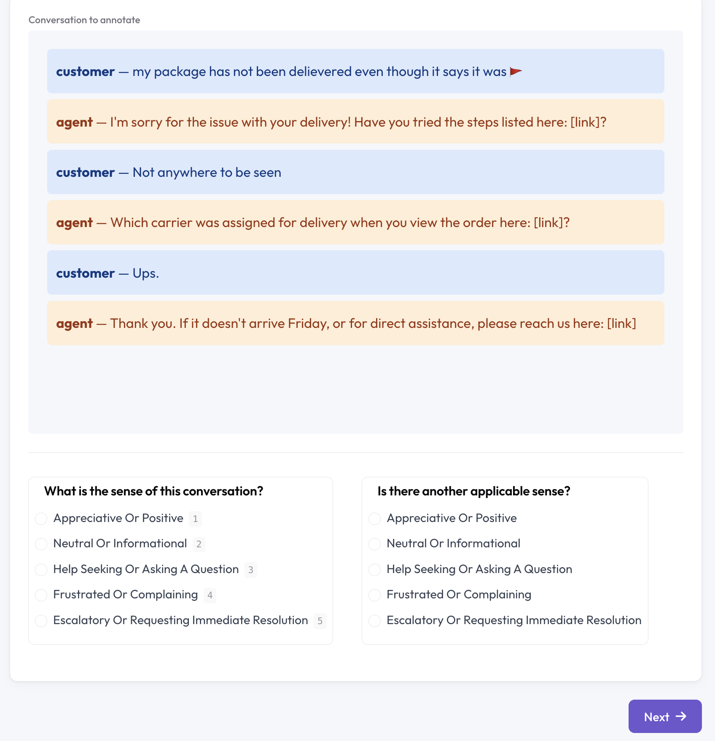
Live Demo
Annotation interface (Potato)
One conversation at a time
Required primary tone label
Optional secondary label
Saves automatically; structured output file
Notes:
Switch to the browser: show a conversation, the five labels, the optional secondary label, and the guidelines panel.

